Slide 1
Database Final Project
team B

Slide 2
introduce
We planned an online shopping mall project that allows users to purchase computer parts based on the search conditions they want.

Slide 3
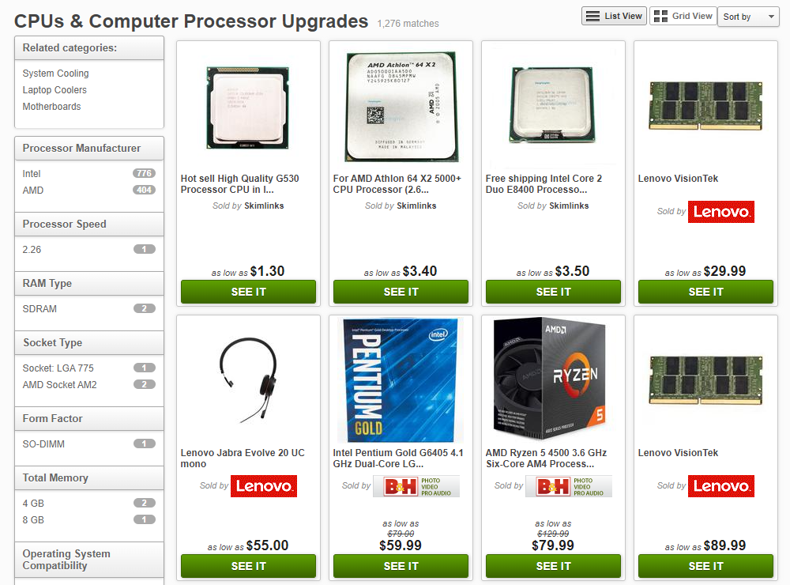
It shows the products searched under the desired product line or detailed conditions.
This helps customers make better choices
ref : http://www.pricegrabber.com/cpus_computerprocessorupgrades/browse/?sort=5

Slide 4
project specification
User is consisted of a seller and a customer
User can search for the product under various conditions.
Customers can purchase various items on a single order.
When customer placing an order, customer must select and enter payment methods, discounts coupons they have, and delivery information.
Seller can register products to sell.
When registering items, separate product lines and register them.
When consumer places an order or a seller registers products, it leaves a log of the user.

Slide 5
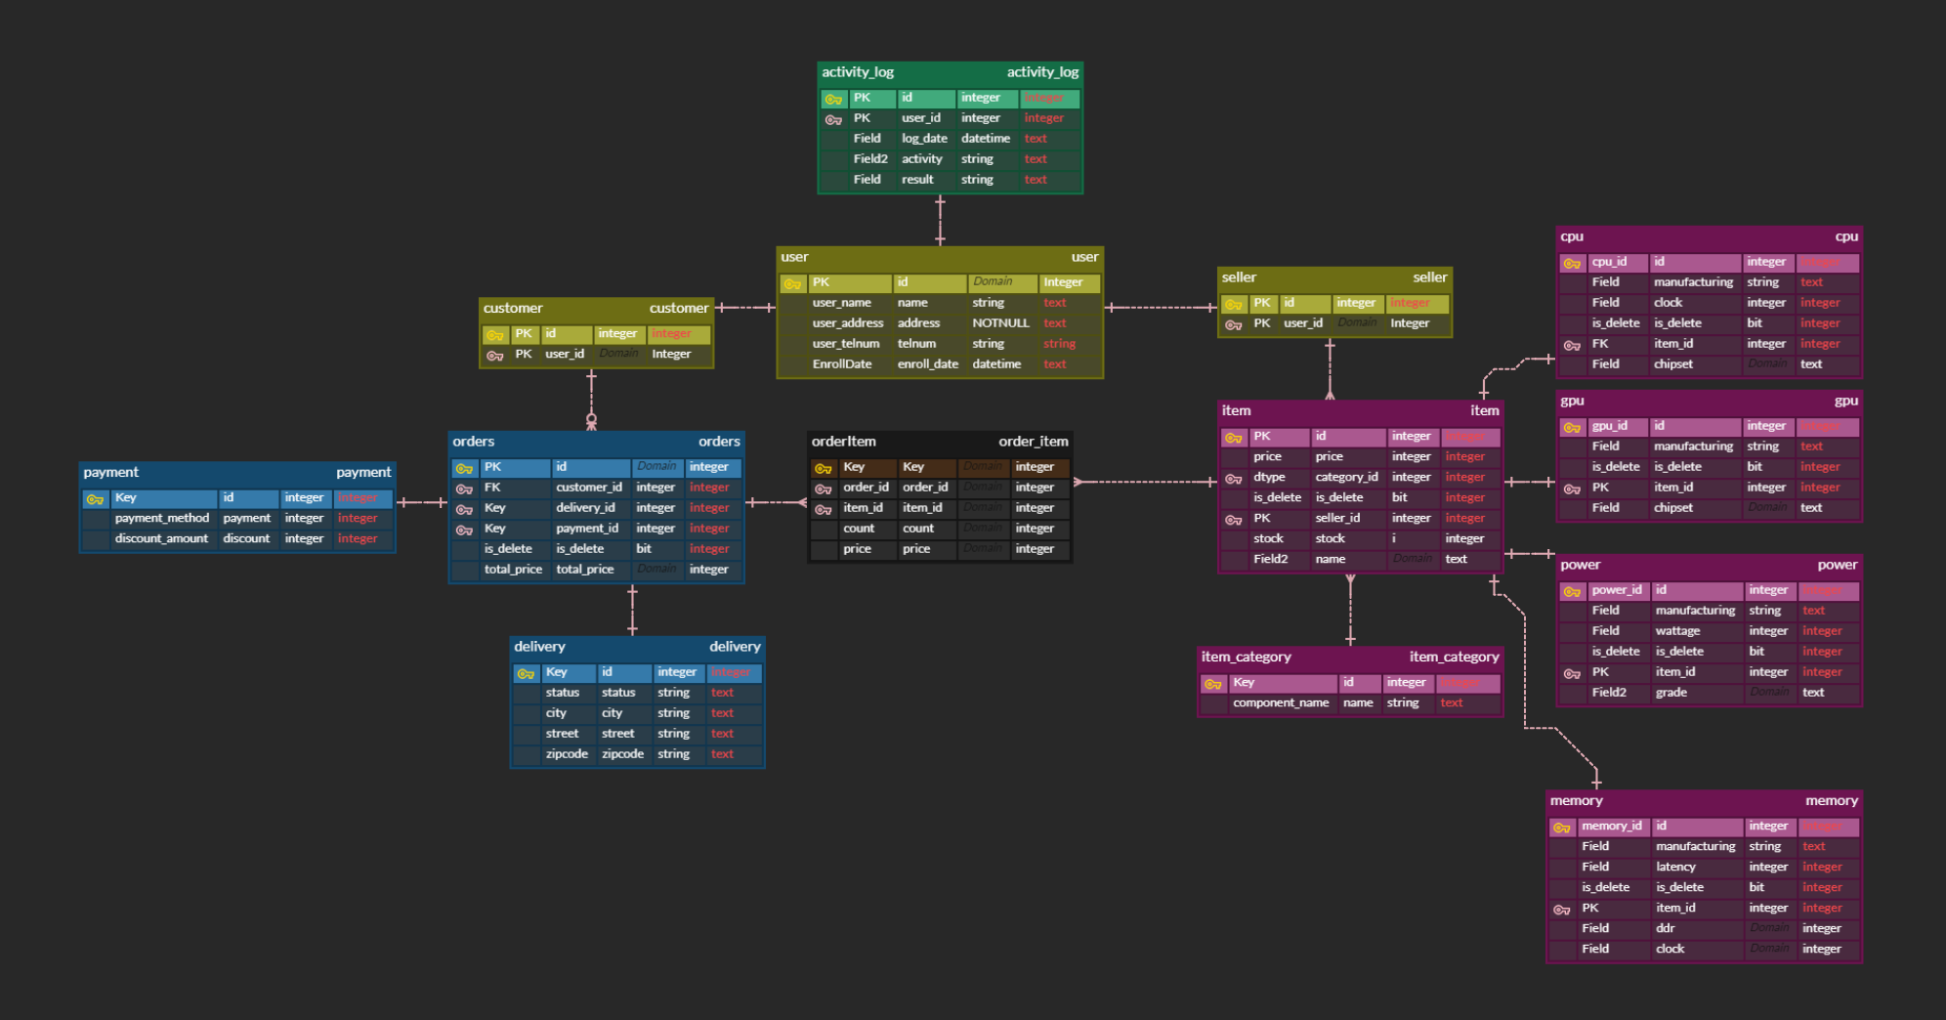
ERD
https://www.erdcloud.com/d/xpuTkFPnALWXkzgLY

Slide 6
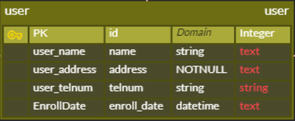


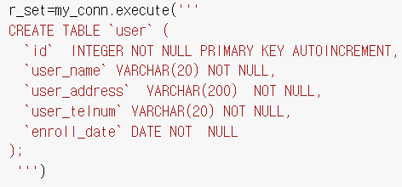
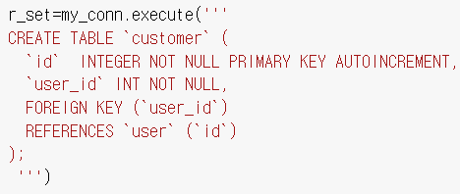
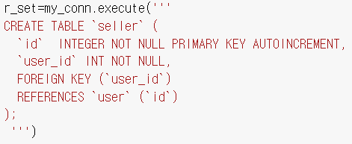
user registration
This is user table. There are one primary key and 4 fields. Table has user id, name, address, telephone number, enrollment date.
This is customer table. There are one primary key and one foreign key. user_id attribute references user table’s id.
This is seller table. There are one primary key and one foreign key. user_id attribute also references user table’s id.

Slide 7
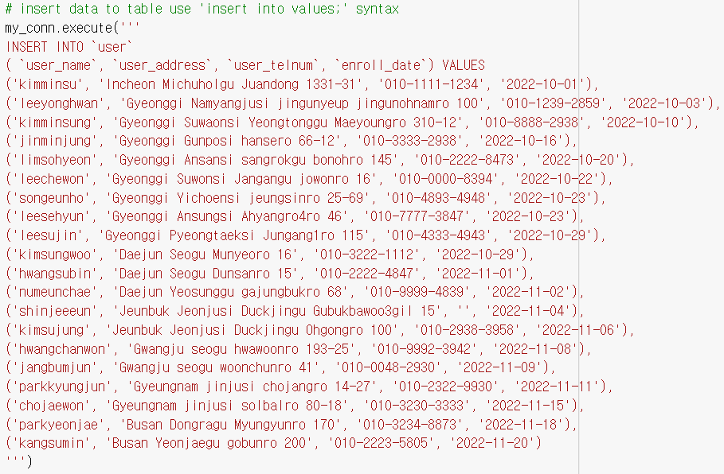
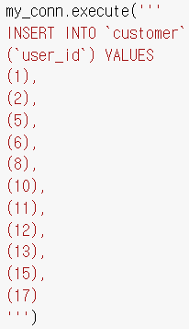
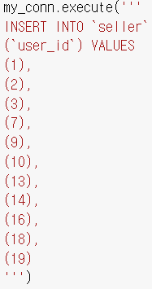
user registration
Insert user table with user name, address, telephone number, enrolled date.
customer, seller table can be inserted like this.

Slide 8
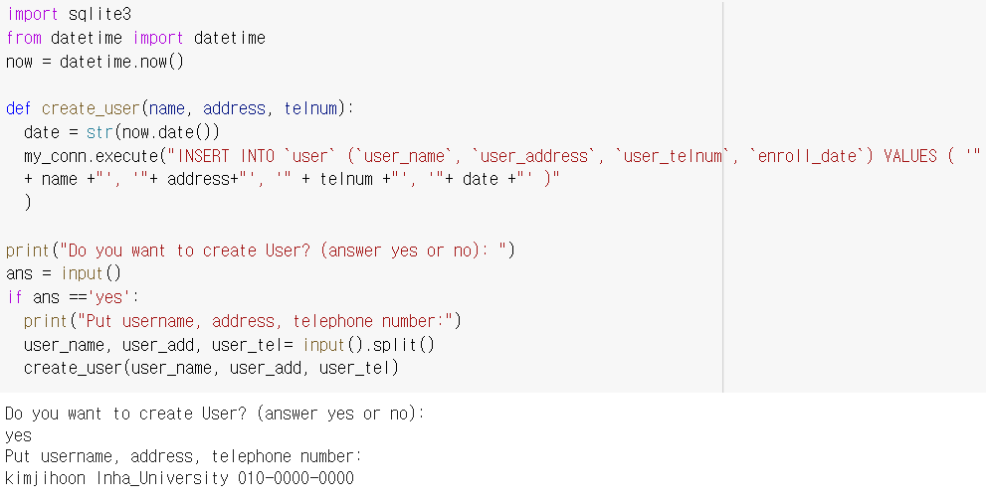
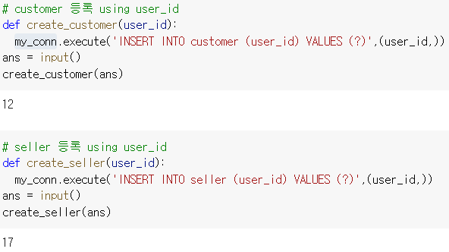
user registration
create_user method can generates user data. Terminal print ‘Do you want to create User? (answer yes or no):
if answer ‘yes’ and put username, address, telephone number then data can be created with these segments.

Slide 9
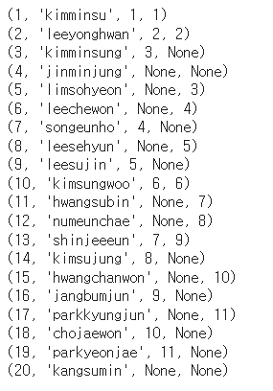
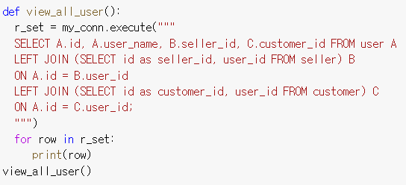
user registration
view_all_user() method join 3 tables with join query. user table has all entity, so use left join. Above result,there hasn’t any data in C.customer_id and B.seller_id column then viewed ‘None’

Slide 10
order,delivery,payment part

Slide 11
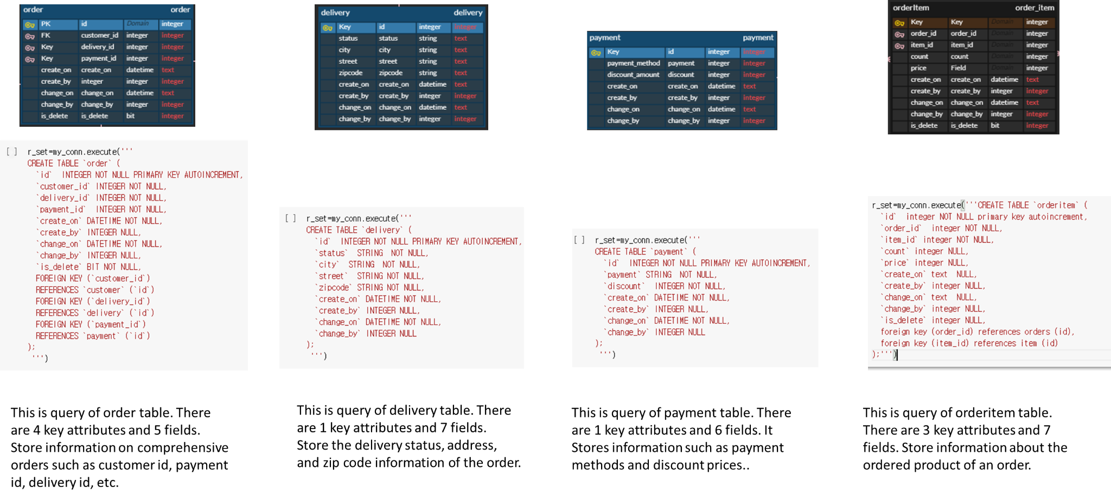

Slide 12
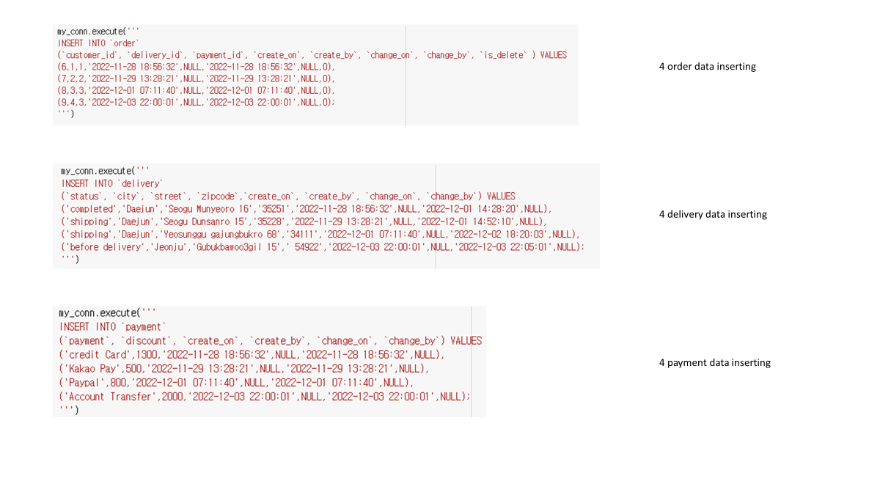

Slide 13
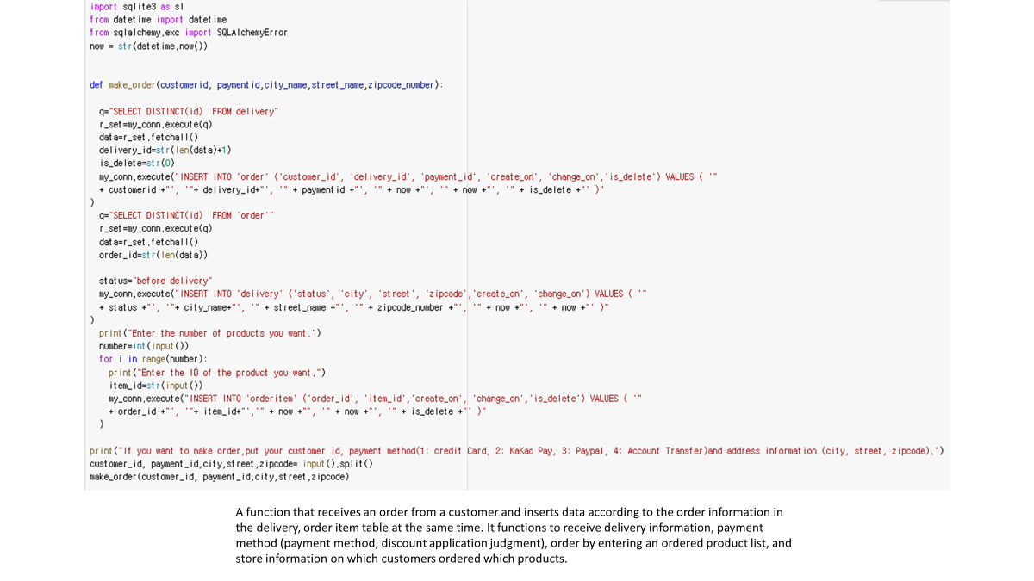

Slide 14
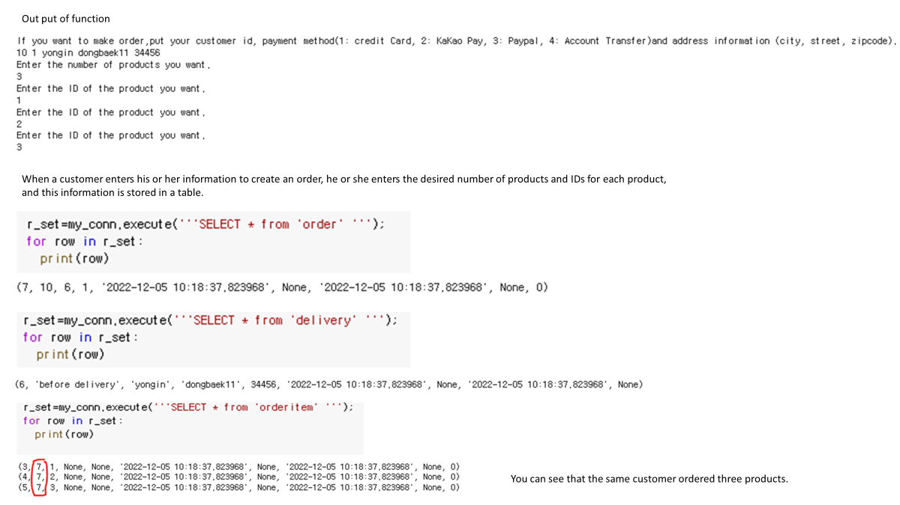

Slide 15
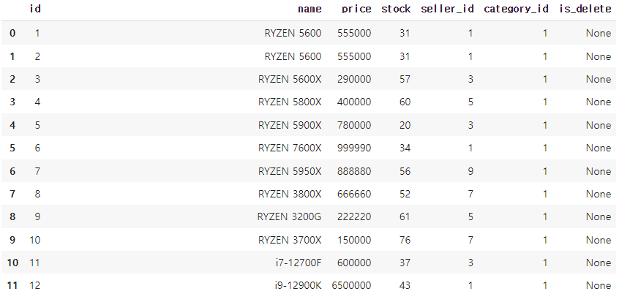
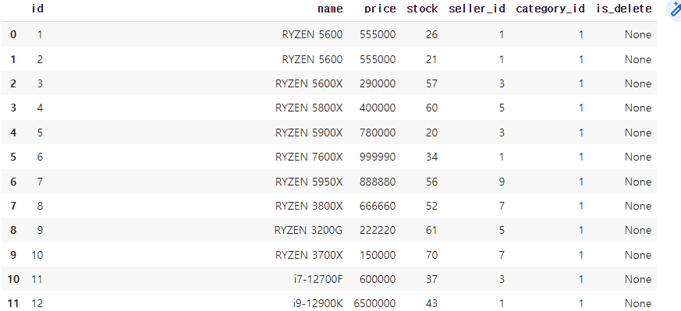
Execute order method
It can be seen that the stock of the item that changes in quantity after ordering changes

Slide 16
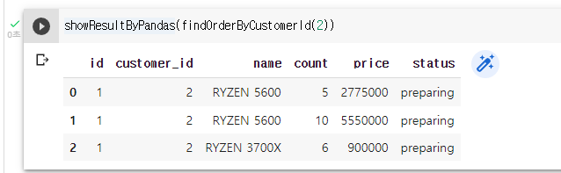
Execute order method
Order information is checked when the order is inquired by the customer's id.

Slide 17
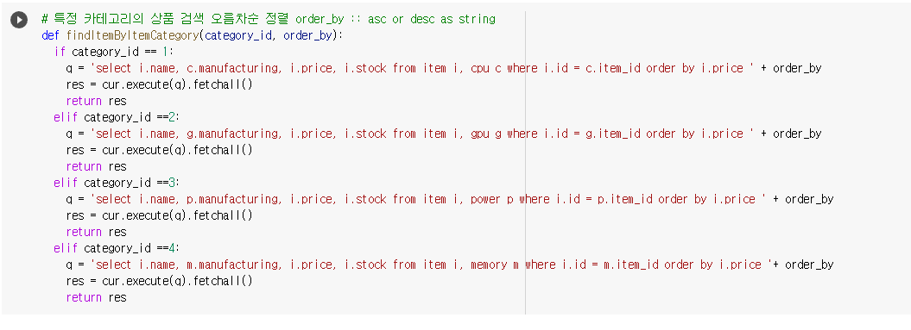
Method for sorting items by price
input value of parameter ‘order_by’ is ‘asc’ or ‘desc’

Slide 18
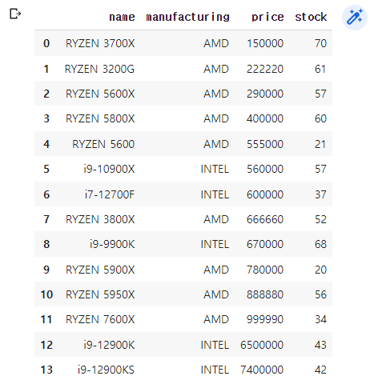
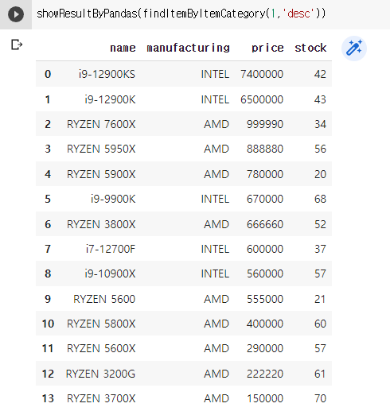
order by ‘asc’ and ‘desc
order by asc
order by desc

Slide 19
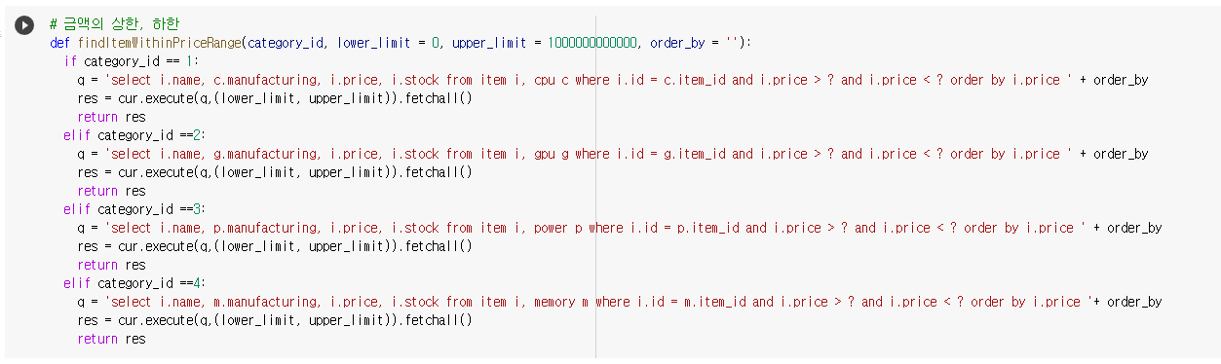
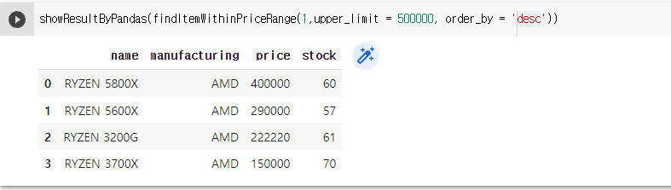
search within price range

